Slide 1
AI-POWERED LEGAL RESEARCH ASSISTANT USING RETRIEVAL-AUGMENTED GENERATION (RAG)
Submitted by V Harshika Reddy – ENG23AM0205
B.Tech CSE (AI & ML) | Guide: Dr Bahubali
RTD NVIDIA Bootcamp

Slide 2
PROBLEM STATEMENT
Legal research remains highly time-consuming due to lengthy statutes, constitutional provisions, and extensive case laws. Professionals and students spend hours manually searching through documents to find relevant precedents and applicable legal provisions.
Traditional keyword-based search systems suffer from critical limitations: they retrieve many irrelevant documents, lack contextual understanding of legal queries, fail to rank results by legal relevance, and often miss jurisdiction-specific citations essential for valid legal arguments.

Slide 3



PROJECT OBJECTIVES
Develop an AI-powered Legal Research Assistant tailored for the Indian legal system, enabling semantic search across statutes, case laws, and constitutional provisions.
Retrieve relevant legal documents via semantic embeddings and rank results by contextual relevance using FAISS vector search and HuggingFace sentence transformers.
Generate accurate, jurisdiction-filtered legal answers with precise citations to Acts, Sections, Articles, and landmark cases using Retrieval-Augmented Generation with NVIDIA Llama 3.1.

Slide 4


EXISTING SYSTEM
Current legal research tools rely on keyword-based search across large databases. Examples include Indian Kanoon, SCC Online, Manupatra, and general search engines like Google. Users must enter exact keywords, browse through extensive result lists, and manually read multiple judgments to find relevant information. This process is time-consuming and requires strong legal vocabulary to retrieve accurate results.
Key limitations: no conversational interface for natural language queries; limited semantic understanding of legal context; users must independently interpret complex legal language; no context-aware ranking of results; and retrieval of irrelevant or excessive documents due to rigid keyword matching.

Slide 5
LITERATURE SURVEY
Lewis et al. (2020) introduced Retrieval-Augmented Generation (RAG), a general-purpose framework combining retrieval with language generation. While effective for open-domain QA, it lacks domain-specific legal knowledge integration and jurisdiction-aware citation handling.
Devlin et al. (2019) proposed BERT for deep contextual understanding of text. However, BERT is not designed for retrieval-based question answering and cannot generate explanatory legal responses with verified citations.
Research Gap: Current systems either retrieve legal documents without explanation or generate ungrounded responses prone to hallucination. Our system bridges this gap by combining semantic retrieval with grounded generation for accurate, citation-backed legal answers.

Slide 6
PROPOSED SYSTEM
Components: Legal Knowledge Base, Semantic Embeddings, FAISS Vector Database, Retrieval-Augmented Generation (RAG), and NVIDIA Llama Large Language Model
Features: Natural language legal queries, context-aware retrieval, and jurisdiction-specific answers with relevant Acts, Sections, Landmark Cases, and source citations
Combines semantic search with grounded generation to deliver accurate, cited legal responses while minimizing hallucination through retrieval-augmented architecture

Slide 7
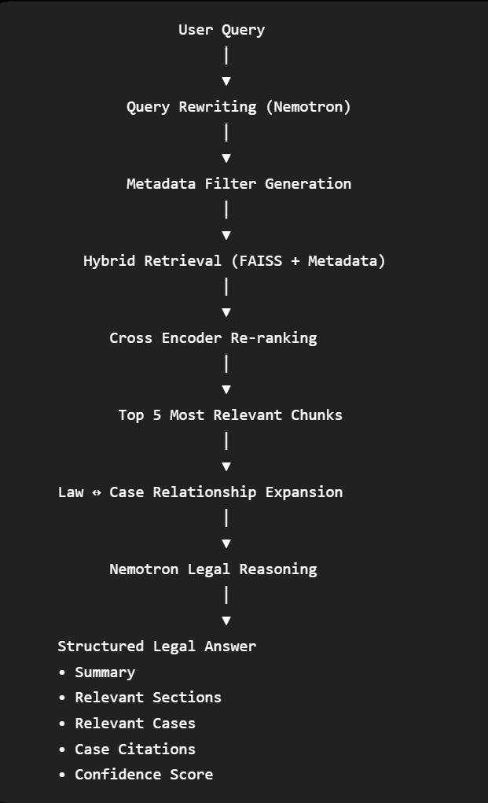
PROPOSED METHODOLOGY
Technical Workflow:
  User submits a natural language legal question
  Question is converted to sentence embeddings via HuggingFace
  FAISS vector search retrieves top-k relevant legal chunks
  Retrieved chunks are fed into NVIDIA Llama 3.1 LLM
  RAG pipeline generates grounded legal answers with citations
  Output includes relevant Acts, Sections, and Landmark Cases
Technologies Used:
• Python, Streamlit (UI framework)
• LangChain (orchestration framework)
• HuggingFace Embeddings (semantic representation)
• FAISS (vector similarity search)
• NVIDIA API + Llama 3.1 (generative LLM)
• Retrieval-Augmented Generation (RAG)

Slide 8
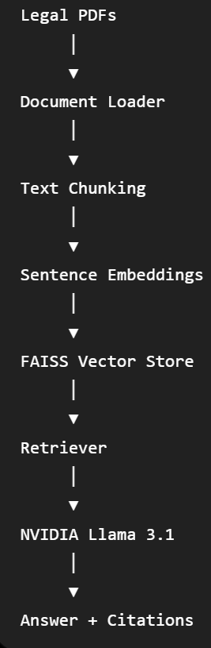
SYSTEM ARCHITECTURE
Our system processes legal documents through a modular pipeline: raw legal PDFs are loaded and chunked, then converted into sentence embeddings stored in a FAISS vector database. At query time, semantic retrieval fetches the most relevant legal passages, which are fed into the NVIDIA Llama 3.1 LLM via a RAG framework to generate accurate, jurisdiction-aware answers with precise citations to Acts, Sections, and landmark cases.

Slide 9
EXPECTED OUTCOMES
Improved efficiency of legal research with reduced manual effort in locating relevant documents across statutes, case laws, and constitutional provisions.
Context-aware legal answers with accurate citations to Acts, Articles, Sections, and Landmark Case Laws ensuring jurisdiction-specific reliability.
Minimized hallucination via Retrieval-Augmented Generation, creating an intelligent assistant for students, lawyers, and legal researchers.

Slide 10
CURRENT PROGRESS
Completed:
• Collection of Indian legal corpus
• Document preprocessing and chunking
• FAISS vector database creation
• Embedding generation
• RAG pipeline implementation
• Streamlit-based Legal Research Assistant
In Progress:
• PDF Case Analyzer
• Improved UI
• Citation Ranking
• Performance Optimization

Slide 11
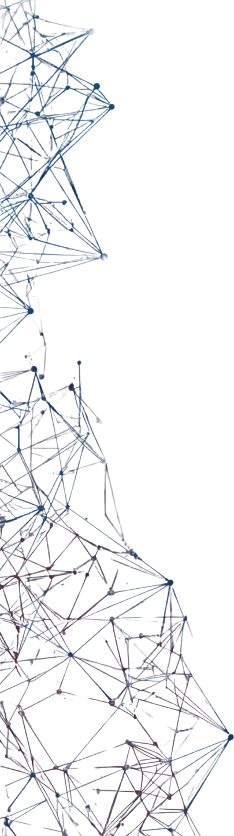
FUTURE SCOPE
Case PDF Analysis
Automatic Legal Summarization
Multi-Jurisdiction Support
Voice-based Legal Assistant
Multi-Agent Legal Reasoning
Continuous Learning from New Judgments
Cross-referencing Multiple Legal Sources
User Feedback Loop for Answer Refinement

Slide 12




THANK YOU

